Slide 1
Pinholes and Pinspecks
Yiqian Wu, Yue Shangguan, Ye Yan
IAVI 2019
Notes:
Non-line-of-light的一个应用
什么是pinhole/pinspeck
Pinhole：小孔成像
Pinspeck: anti-pinhole, 通过遮挡物遮挡掉部分光的图片与无遮挡物的图片相减，可以获得以遮挡物为小孔的图像信息

Slide 2
What we need
Easy equipment:
-- a box
-- several white papers
-- ipad/outside view
-- curtain
-- fixed focal camera…

Slide 3
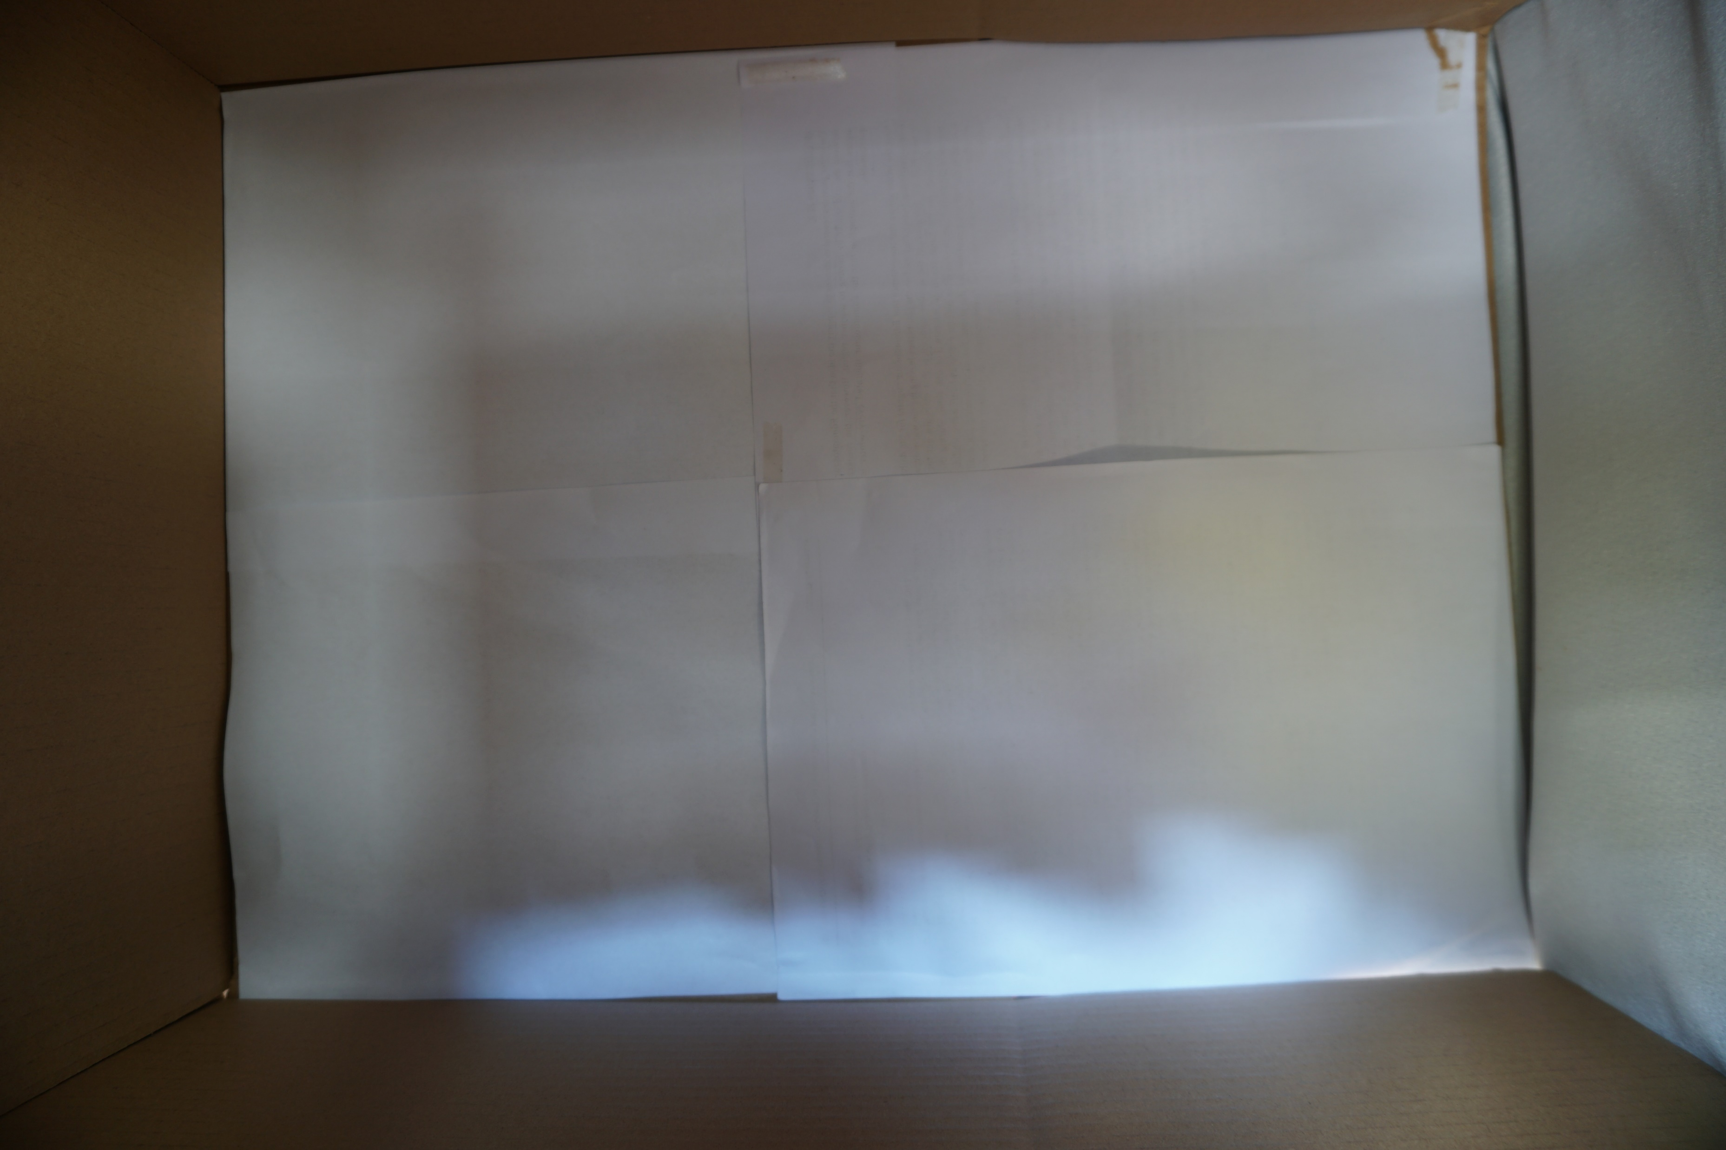
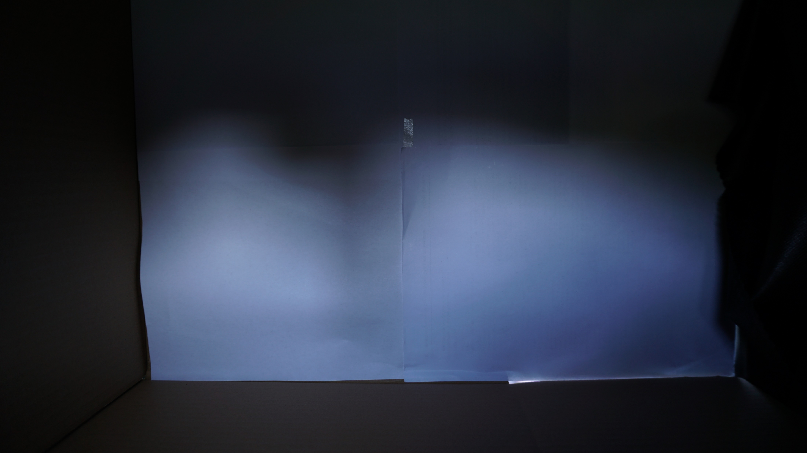
Accidential pinholes and pinspecks in life…
· windows acting as ‘pinholes’ revealing scene outside on the wall
Notes:
窗户是生活中常见的小孔…
在我们的纸箱上开一个洞 获取的室外信息

Slide 4
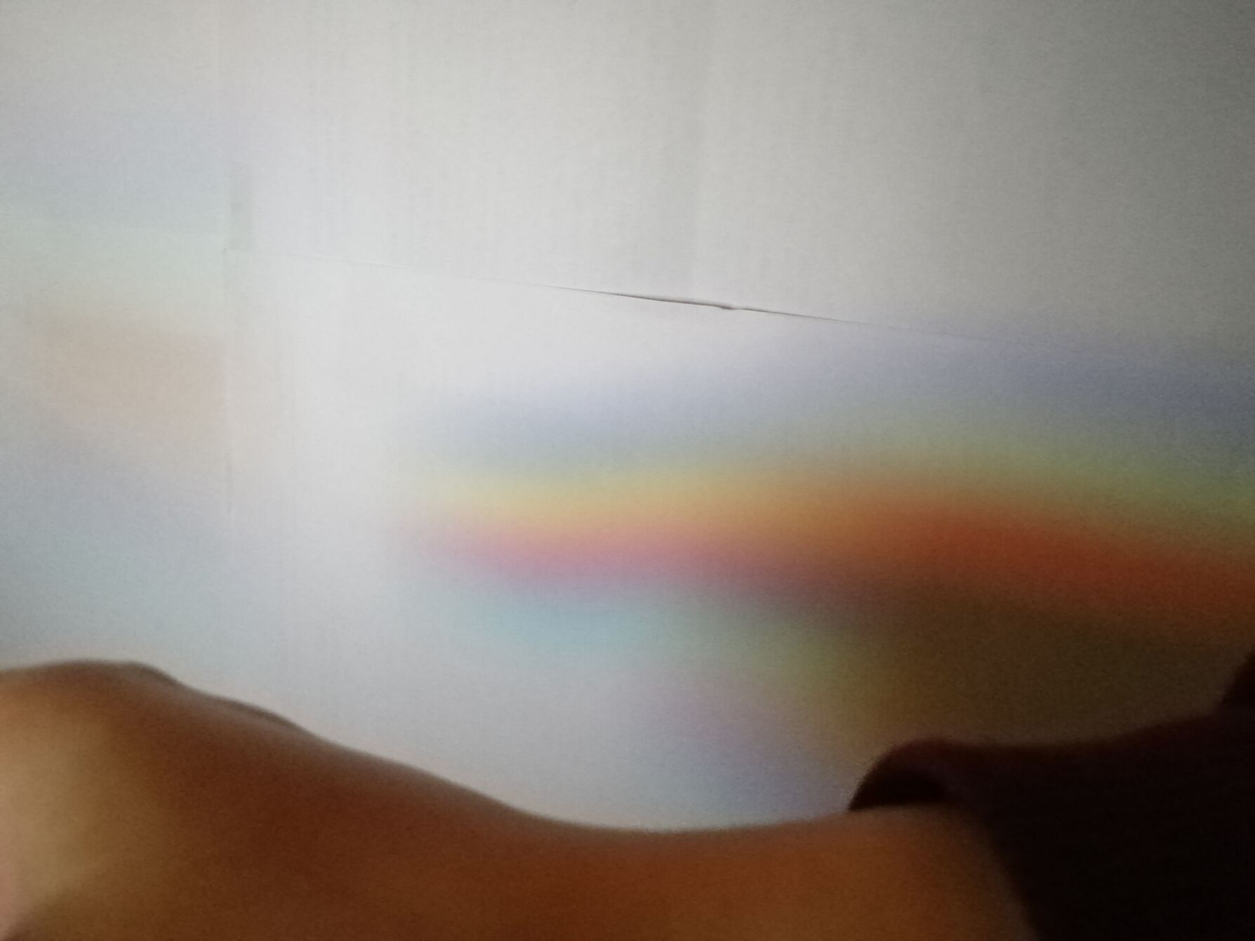
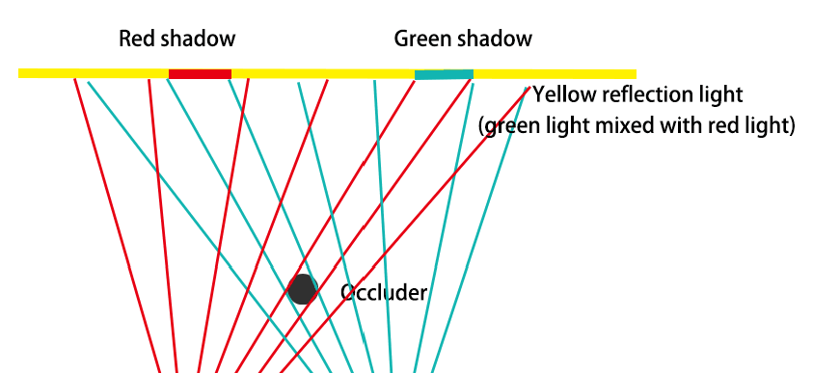
Accidential pinholes and pinspecks in life…
· shadows carry color and light information
Notes:
shadow可以携带有效信息和颜色

Slide 5
the math of pinspeck
I occluder (x, y) = I background (x, y) − I pinhole (x, y)
I pinhole (x, y) = I background (x, y) − I occluder (x, y)
= ρ(x, y)(L(x, y) − L occluder (x, y))
= ρ(x, y)(T hole (x, y) ∗ S(x, y))
illumination image
albedo variations
The ideal pinhole image
aperture
Notes:
Albedo反射
I 相机捕获的图像信息
L 外界物体通过窗口的illumination image
Ρ 白纸的反射

Slide 6
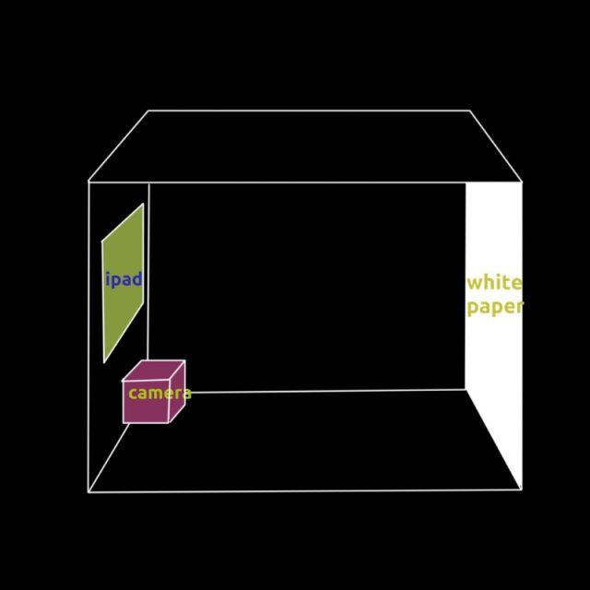

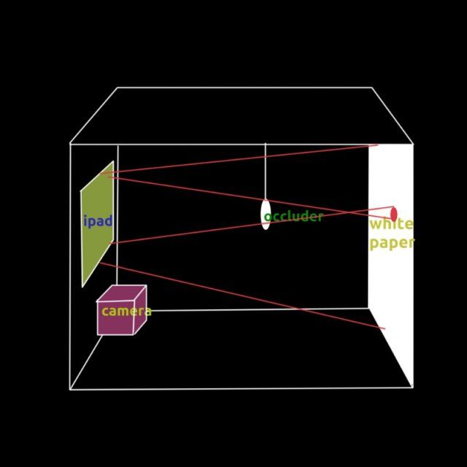
Our setup - with light from iPad
·

Slide 7
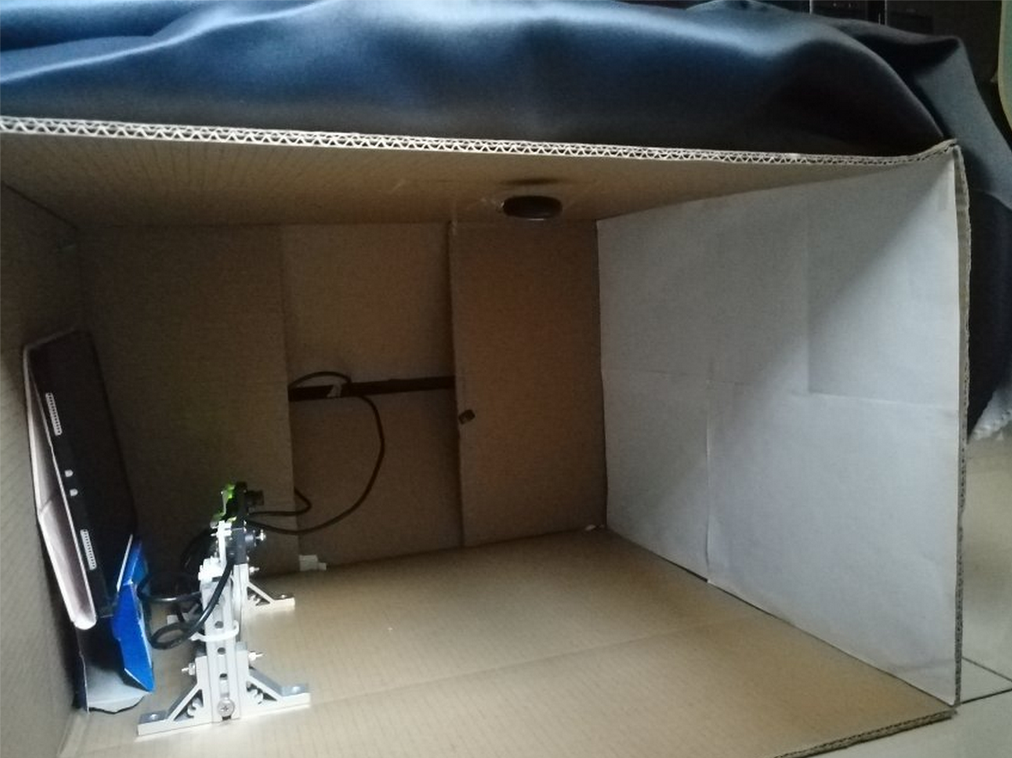
Our setup - with light from iPad
·

Slide 8
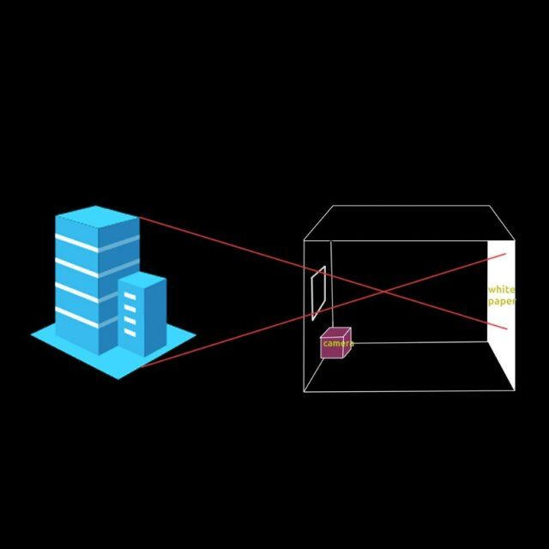
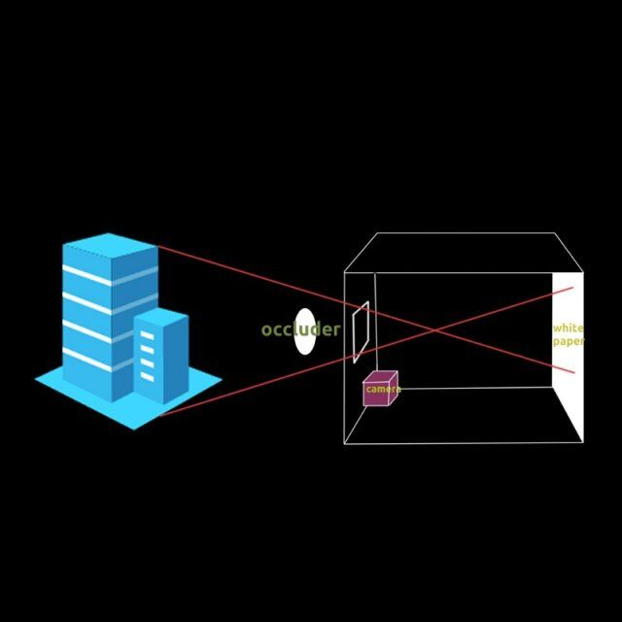
Our setup - with light from outside
Notes:
拍摄视频

Slide 9
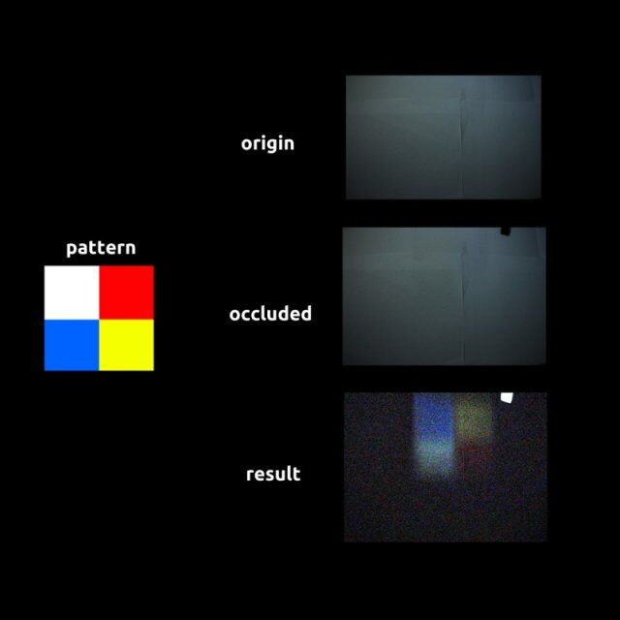
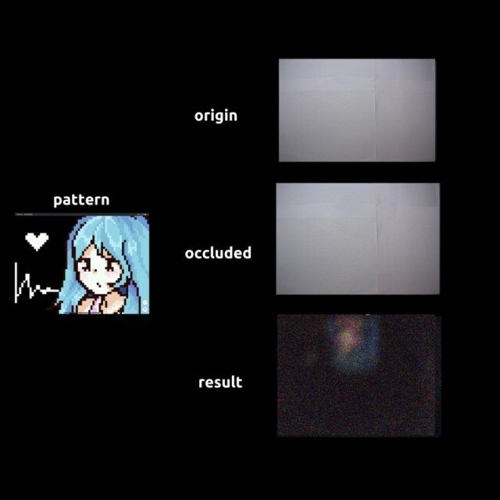
Results - with light from iPad
Notes:
噪声较小

Slide 10
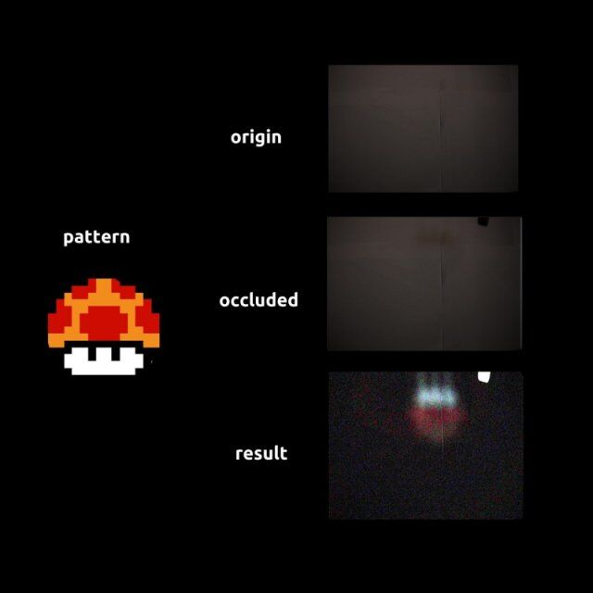
Results - with light from iPad

Slide 11
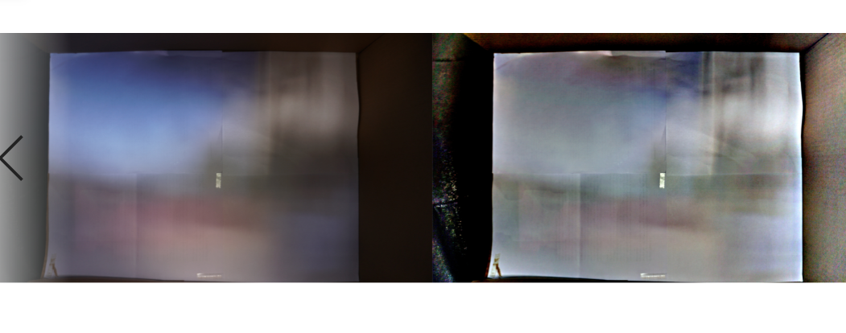
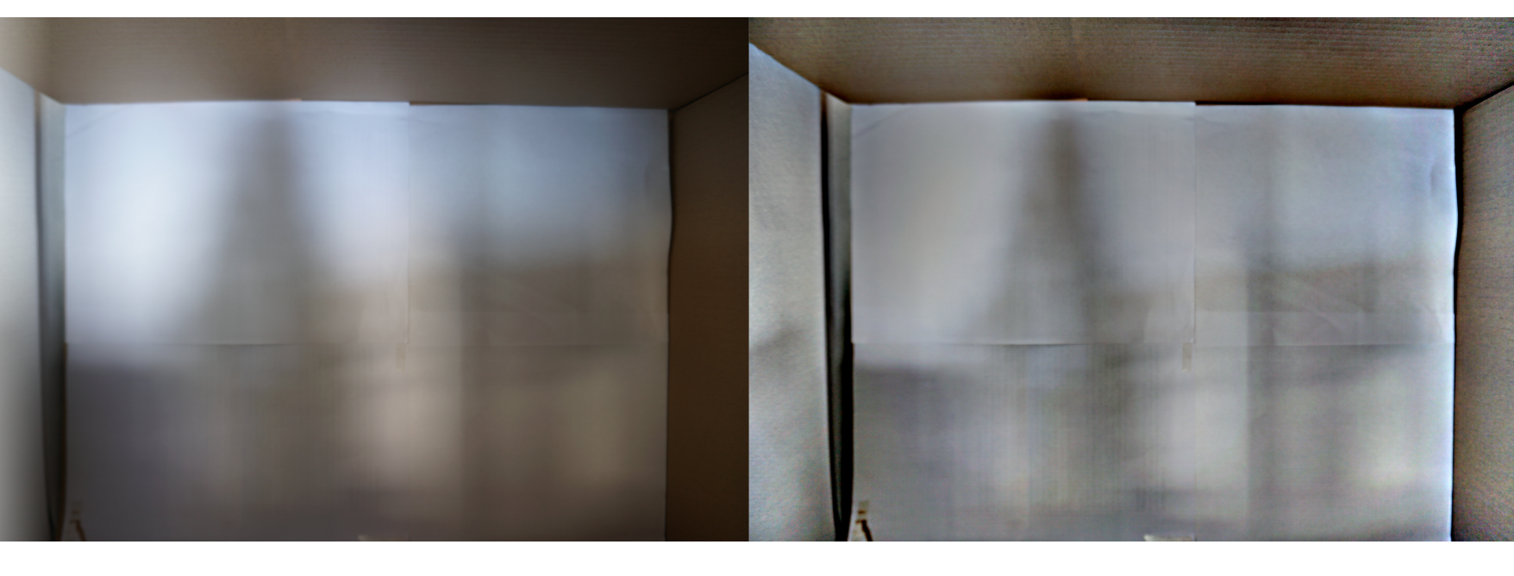
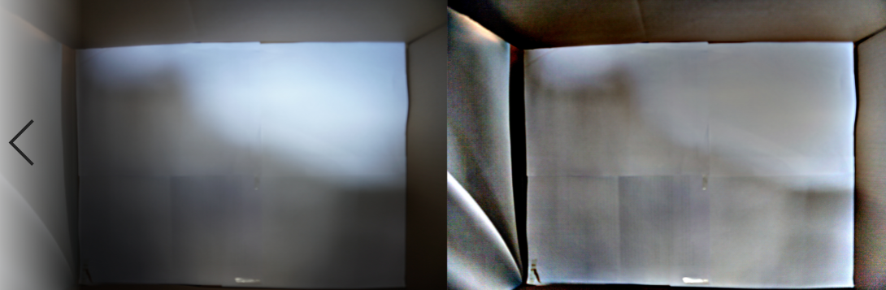
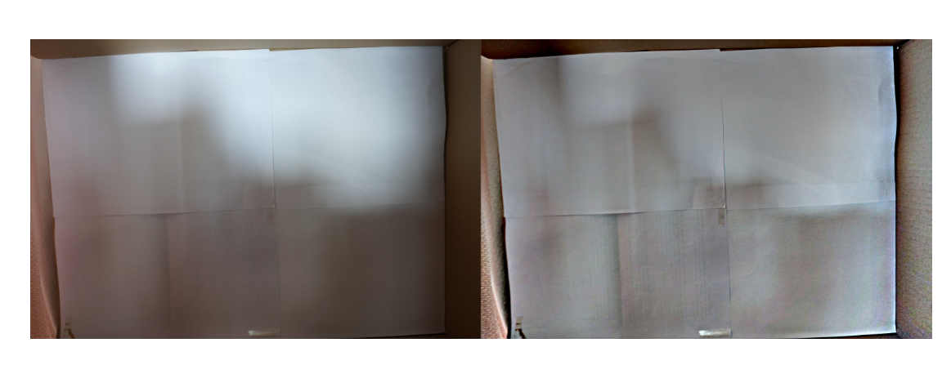
Results – sharpening pinhole images with MSRCR deblurring
Notes:
图像增强算法
retinex算法就是为那些在外界环境不理想的状态下拍摄的图像增强而设计的。
其中，R(x, y)表示了物体的反射性质，即图像内在属性，我们应该最大程度的保留；而L(x, y)表示入射光图像，决定了图像像素能达到的动态范围，我们应该尽量去除。
物理意义是通过计算像素点与周围区域在加权平均的作用下，估计图像中照度的变化，并将L(x,y)去除。
1. the reflectance image of the interior scene
2. the shading components of the interior scene
3. the projected image of the outside world, blurred by the
accidental camera aperture.
Retinex works much better for the task of extracting accidental images than to separate (1) from (2), because the accidental camera aperture blurs things so much.

Slide 12
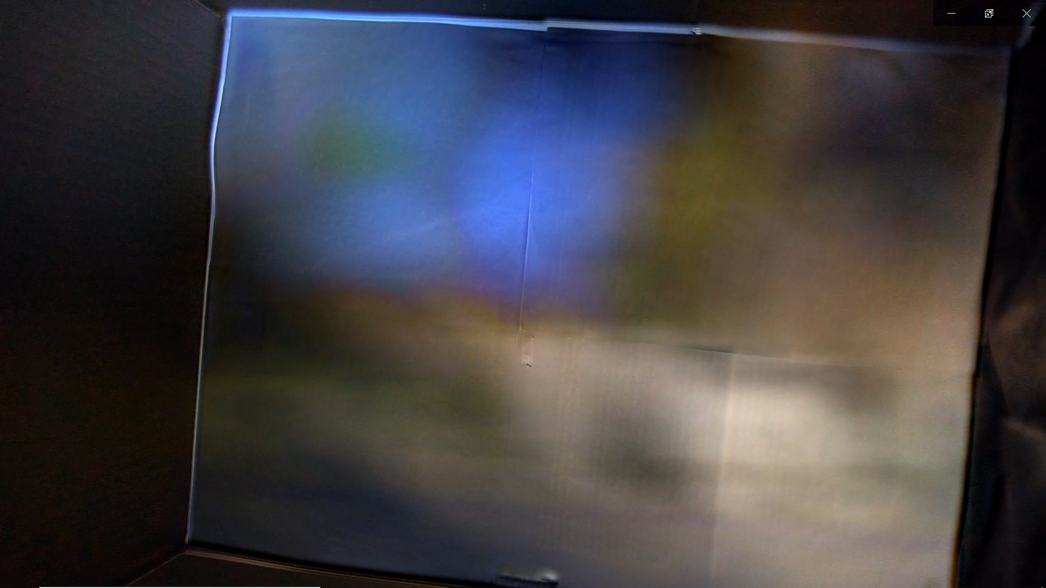
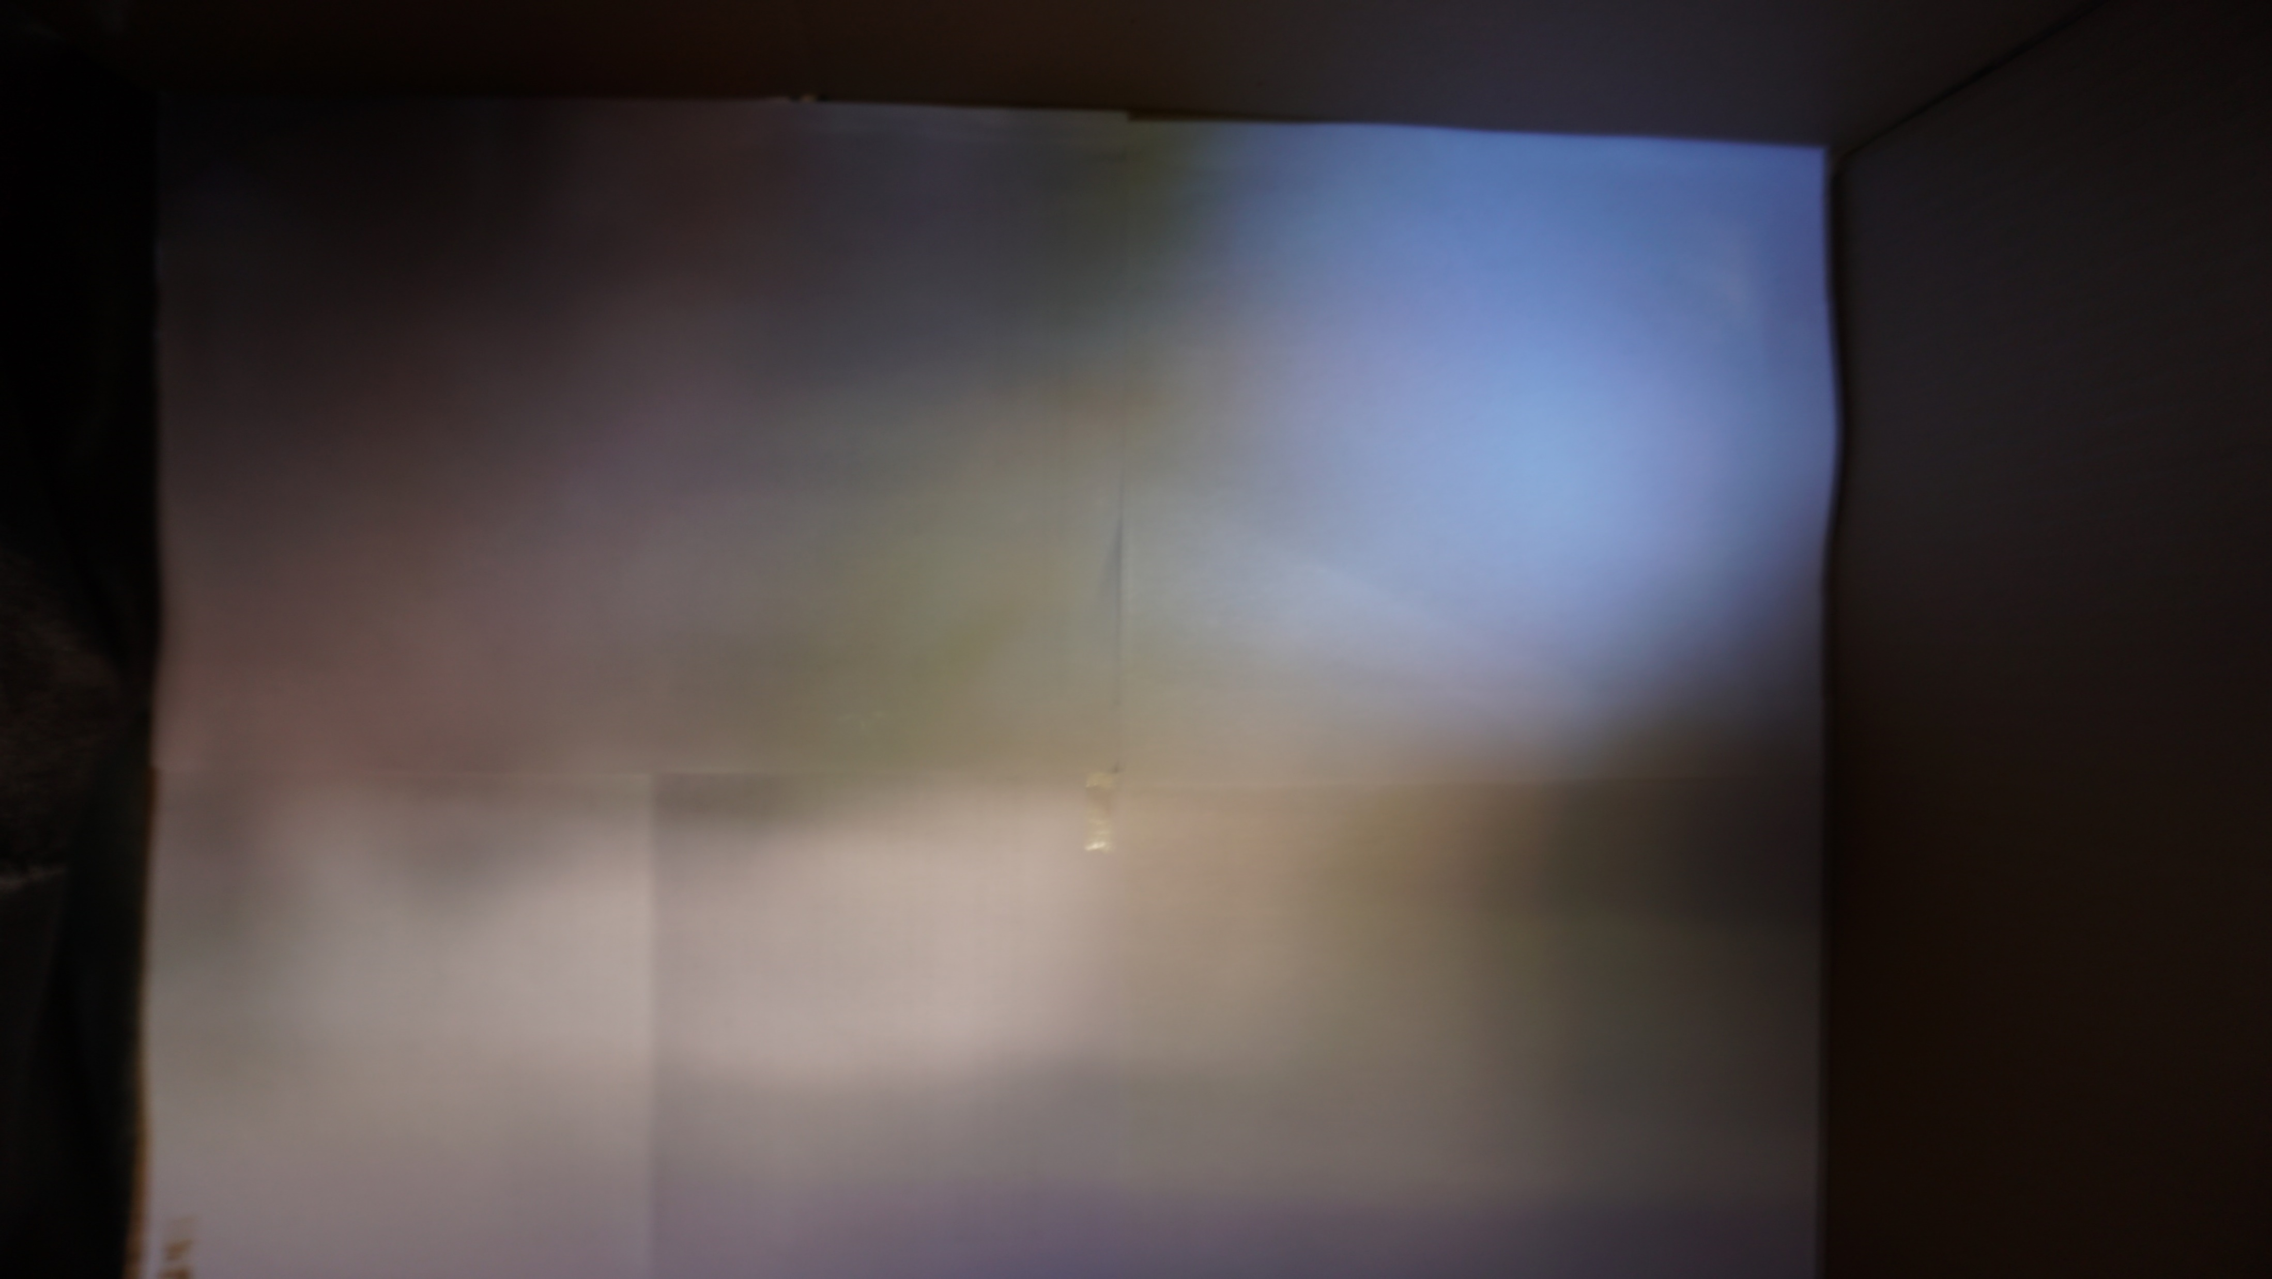
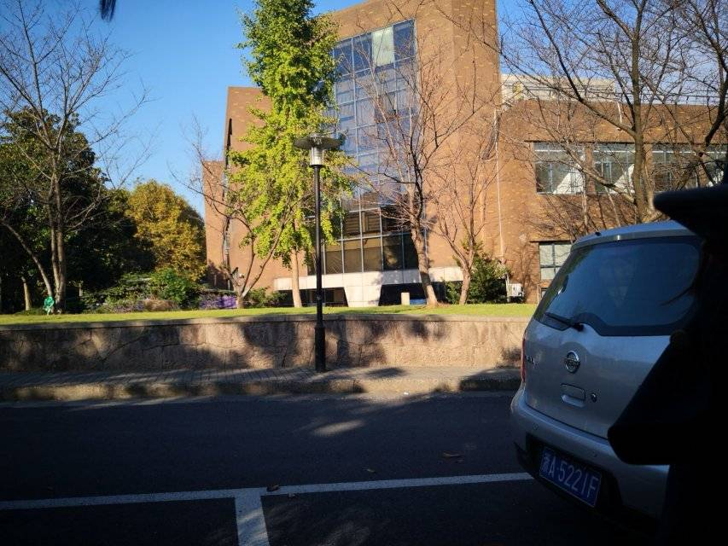
Results - with light from outside
Original l
Combination of pinspeck series
Single pinhole
Notes:
选取了八帧 对于每一个像素点取每个rgb通道的最大值 显著优于 有比较充分的细节
Original是人站在箱子旁边拍的，所以视角略有不同 箱子的视角比original要更加偏左偏矮一些

Slide 13
Acquiring data…
· Using industrial camera / SLR camera /
the front camera on phones(with fixed lens)
· Sunlight at noon / late afternoon /
cloudy / shiny daytime
· Focus on object with large / little diffuse reflectance

Slide 14
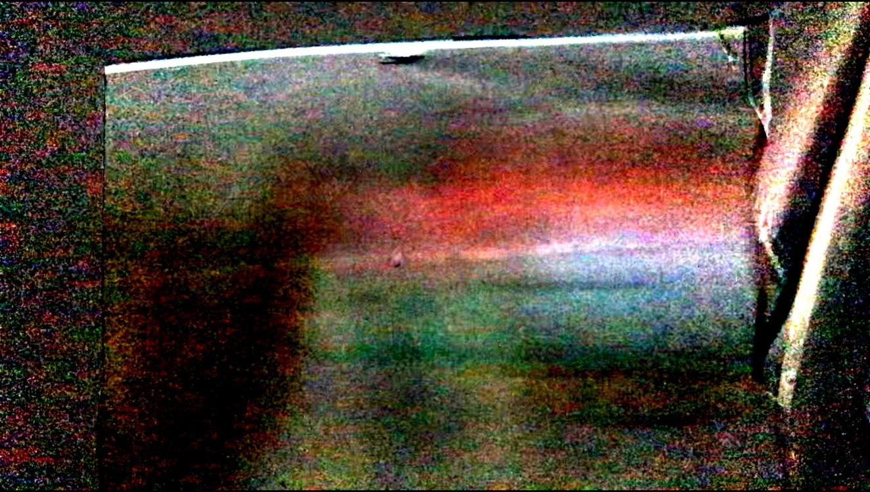
Our further goal
· Use pinholes and pinspecks together
sharper, less loss on colors, and more details
· Denoise on pinspecks
Pinspeck image of a red car

Slide 15
Reference
· Accidental Pinhole and Pinspeck Cameras, Revealing the Scene Outside the Picture, Antonio Torralba · William T. Freeman, 2014
· Computational periscopy with an ordinary digital camera, Charles Saunders, John Murray-Bruce, Vivek K Goyal, 2019

Slide 16
Thank you !

